Slide 1
Linear Regression

Slide 2
Agenda
Linear Regression Overview
Multiple Linear Regression
Least square example
Coefficient of Determination
R-squared
Advantages and Disadvantages

Slide 3
What is linear regression?
Linear regression is one of the supervised learning algorithms that are used to identify a relationship between two or more variables.
This relationship can be used to predict values for one variable, if value(s) of other variable(s) is given.

Slide 4
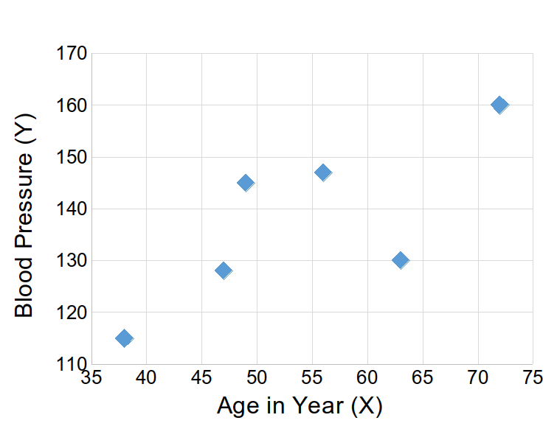
Linear regression
The points in this scatter plot can be clustered around a curve, that is known as the regression curve
If the curve is a linear line, then it is said linear regression

Slide 5
Regression Model
Relationship between one dependent variable and explanatory variable(s)
Use equation to set up relationship
Numerical Dependent (Response) Variable
1 or More Numerical or Categorical Independent (Explanatory) Variables
Used Mainly for Prediction & Estimation

Slide 6
Types of Regression Models
1 Explanatory
Variables
Regression
2+ Explanatory
Variables
Models
Simple
Multiple
Non-
Non-
Linear
Linear
Linear
Linear
Notes:
24
This teleology is based on the number of explanatory variables & nature of relationship between X & Y.

Slide 7
Prediction Method
Method | No. of independent variables | No. of dependent variables | Type of Dependent variable
Simple linear Regression | 1 | 1 | Real
Multiple Linear Regression | > 1 | 1 | Real
Logit Regression | >1 | 1 | Real / Categorical
Artificial Neural Network | >1 | >1 | Real / Categorical

Slide 8
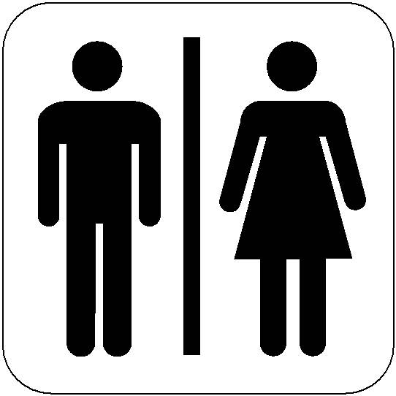
Simple Linear Regression
Simple Linear regression models are used to show or predict the relationship between two quantitative Variables.
Data can be Visualized using Scatter Plot.
Linear Regression is a where your relationship between 2 variables can be represented by a straight line
in
Kg
Kg

Slide 9
Types of variable in Regression
Dependent Variable
Independent Variable

Slide 10
Dependent variable
A dependent variable is what you measure in the experiment and what is affected during the experiment. The dependent variable responds to the independent variable. It is called dependent or response variable.
e,g. Weight of a person depends on his/her Height. In this case Weight is a dependent variable

Slide 11
Independent Variable
An independent variable, sometimes called an experimental or predictor variable, is a variable that is being manipulated in an experiment in order to observe the effect on a dependent variable, sometimes called an outcome variable or exploratory Variable.
Eg. Height, gender is a independent variable
Note : if its only one exploratory variable then its called as simple linear regression

Slide 12

Example 1
Is it possible to do this prediction ?
Predict weight(Y variable) of a person based on his/her age ?
Dependent Variable (X) - Weight
Independent or
responsive Variable (Y) - Age
Note : Since the independent Variable is restricted to one variable, this method of regression is called as Simple Linear Regression

Slide 13
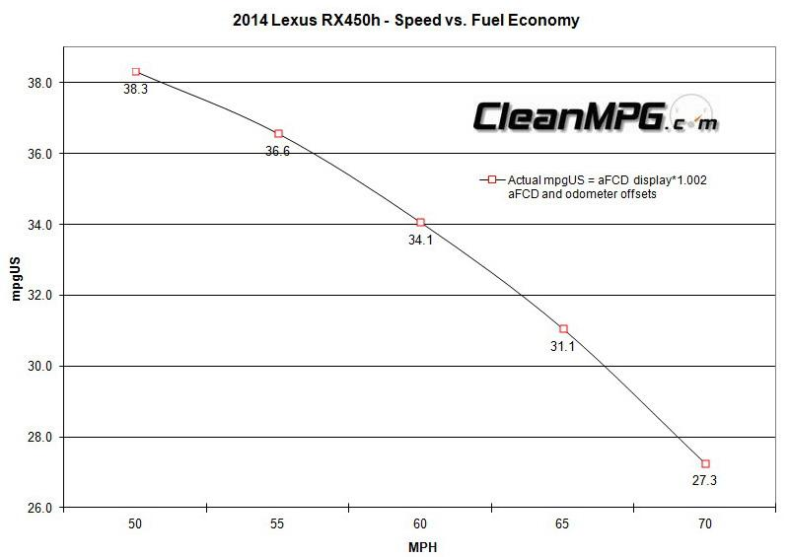
Example 2
Driving speed and gas mileage
As driving speed increases, you'd expect gas mileage to decrease, but not perfectly.

Slide 14
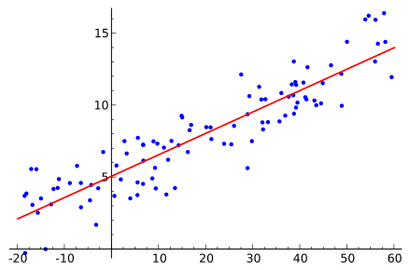
Assumptions
Linear regression assumes that relationship between variables can be modeled through a linear equation or equation of a line.
It assumes that independent variables are related linearly to response variables

Slide 15
Mathematical notation
Equation for linear regression is given by y = mx + c
In machine learning we represent the same equation as y = w₀ + w₁ x
Where w₀ is the intercept on y-axis, w₁ is the slope of the line, x is the independent variable, and y is the dependent variable

Slide 16
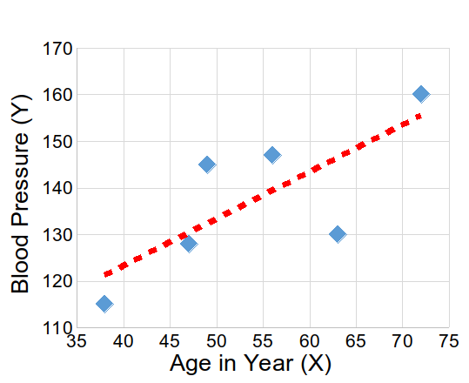

Objective
Linear regression aims to find the best fit line
Best fit line explains the variance in the data
This line always passes through the mean of the data variables

Slide 17



Best fit line
Learning from the data, model generates a line that fits the data
There can be many lines that try to fit the data points in scatter diagram

Slide 18
Methods to get the best fit line
Two methods can be used to find the best fit line
Principle of least squares
Gradient descent

Slide 19
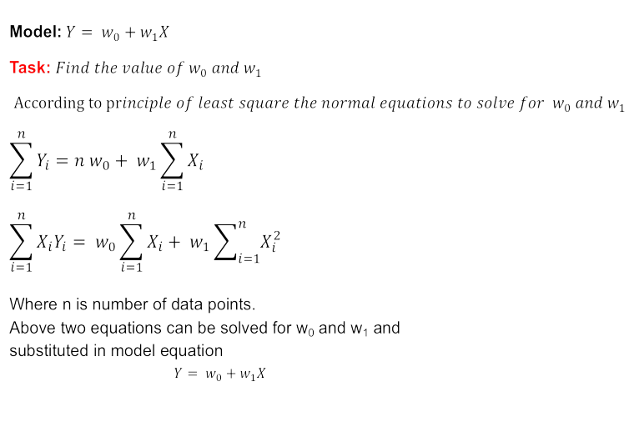
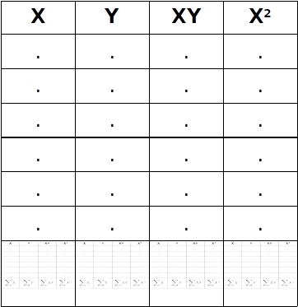
Least square

Slide 20
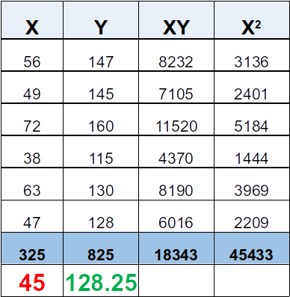
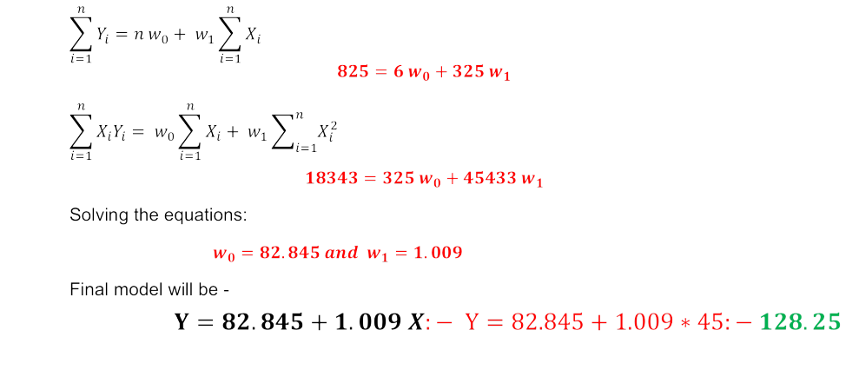
Least square example

Slide 21
Multiple regression
A statistical technique that simultaneously develops a mathematical relationship between two or more independent variables and an interval-scaled dependent variable. (Multiple regression involves a single dependent variable and two or more independent variables)

Slide 22
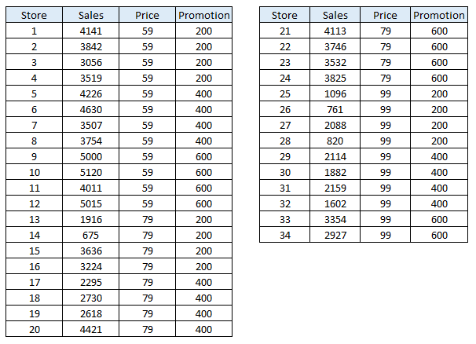
Multiple regression: sample data

Slide 23
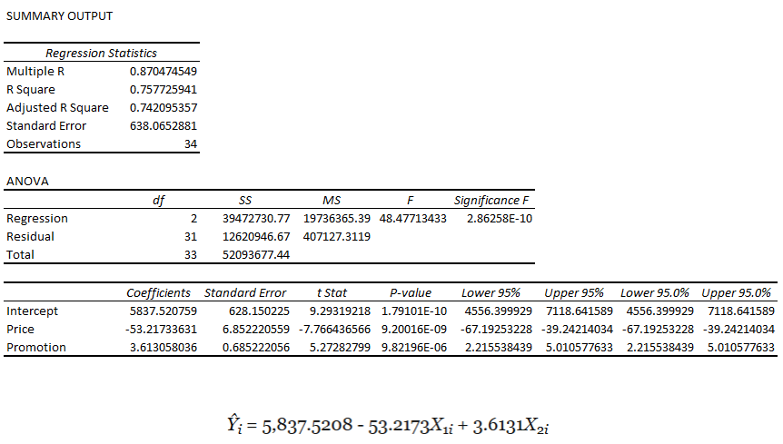
Regression output

Slide 24
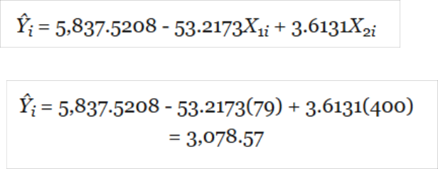
Multiple regression: example
Multiple regression equation to predict values of the dependent variable.
For example, what are the predicted means sales for a store charging 79 cents during a month in which promotional expenditures are $400?
For the stores charging 79 cents and $400 in promotional expenditures the mean sales will be 3,078.57

Slide 25
R-square
Using the sample store data
r2 = 0.7577
This indicates that 75.77% of the variation of sales is explained by the variation in the price and in the promotional expenditures.

Slide 26
Advantages
Simple to implement
It’s easier to interpret the output coefficients
Disadvantages
Always assumes a linear relationship between dependent and independent variable
Can easily get affected by outliers
Assumes independence between attributes

